Slide 1
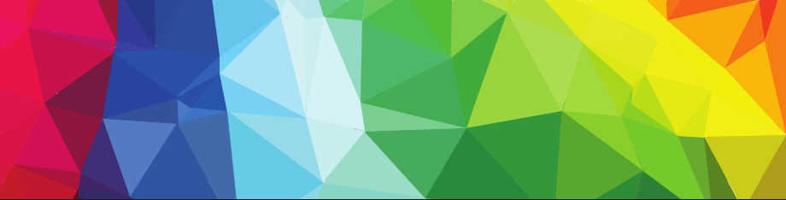

GUI Design. Mockup
Падус Софія, ПМІ - 51

Slide 2
Agenda
Introduction
UI Design
UX vs UI
UX designers vs UI designers
Design Thinking Process
GUI
Are GUI and UI the same?
GUI History
GUI Design Principles
Design Tools & Websites for GUI Designers
Advice
Mockups
What is mockup
Mockups benefits
Mockups vs wireframes and prototypes
Mockups tools
Design best practices
Common Errors of UI Designers
Website Design
Navigation design
Buttons design

Slide 3
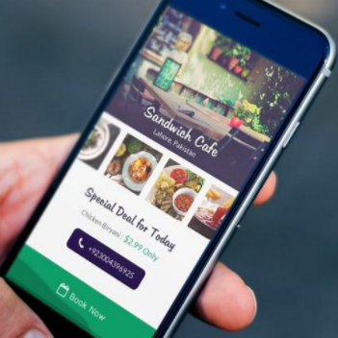
UI Design
User interface design (UI) or user interface engineering is the design of user interfaces for machines and software, such as computers, home appliances, mobile devices, and other electronic devices, with the focus on maximizing usability and the user experience.
The goal of user interface design is to make the user's interaction as simple and efficient as possible, in terms of accomplishing user goals (user-centered design).

Slide 4
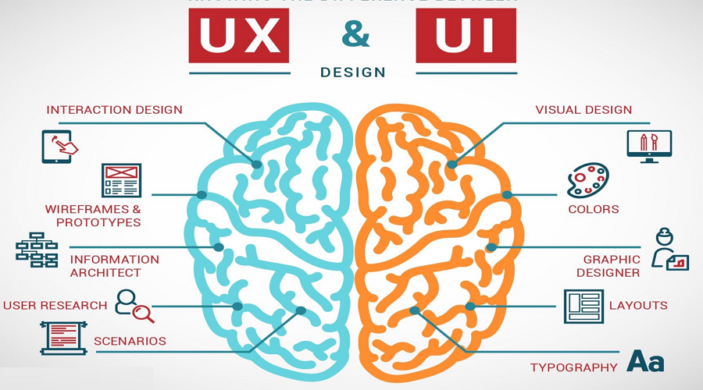
UX vs UI

Slide 5
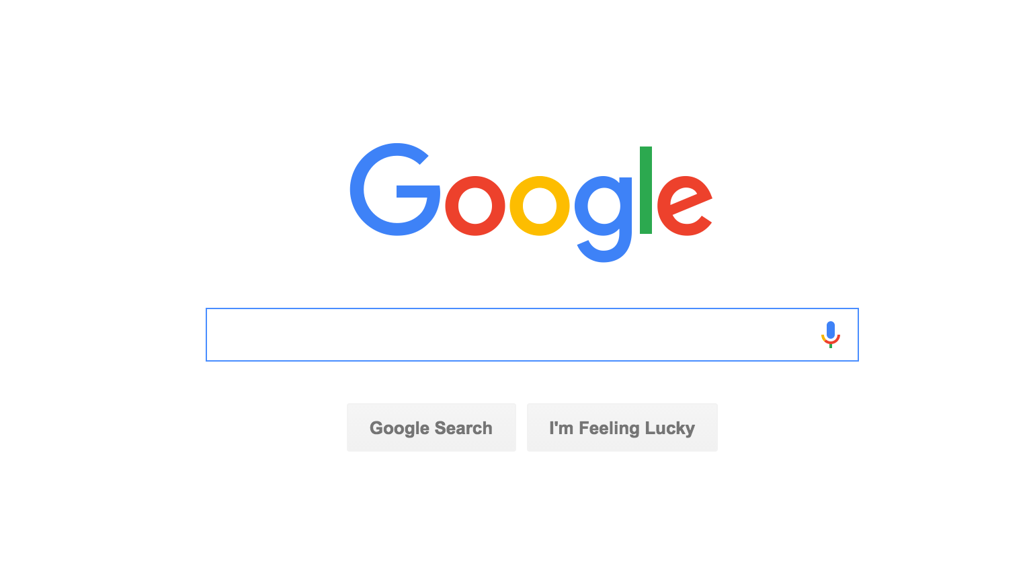
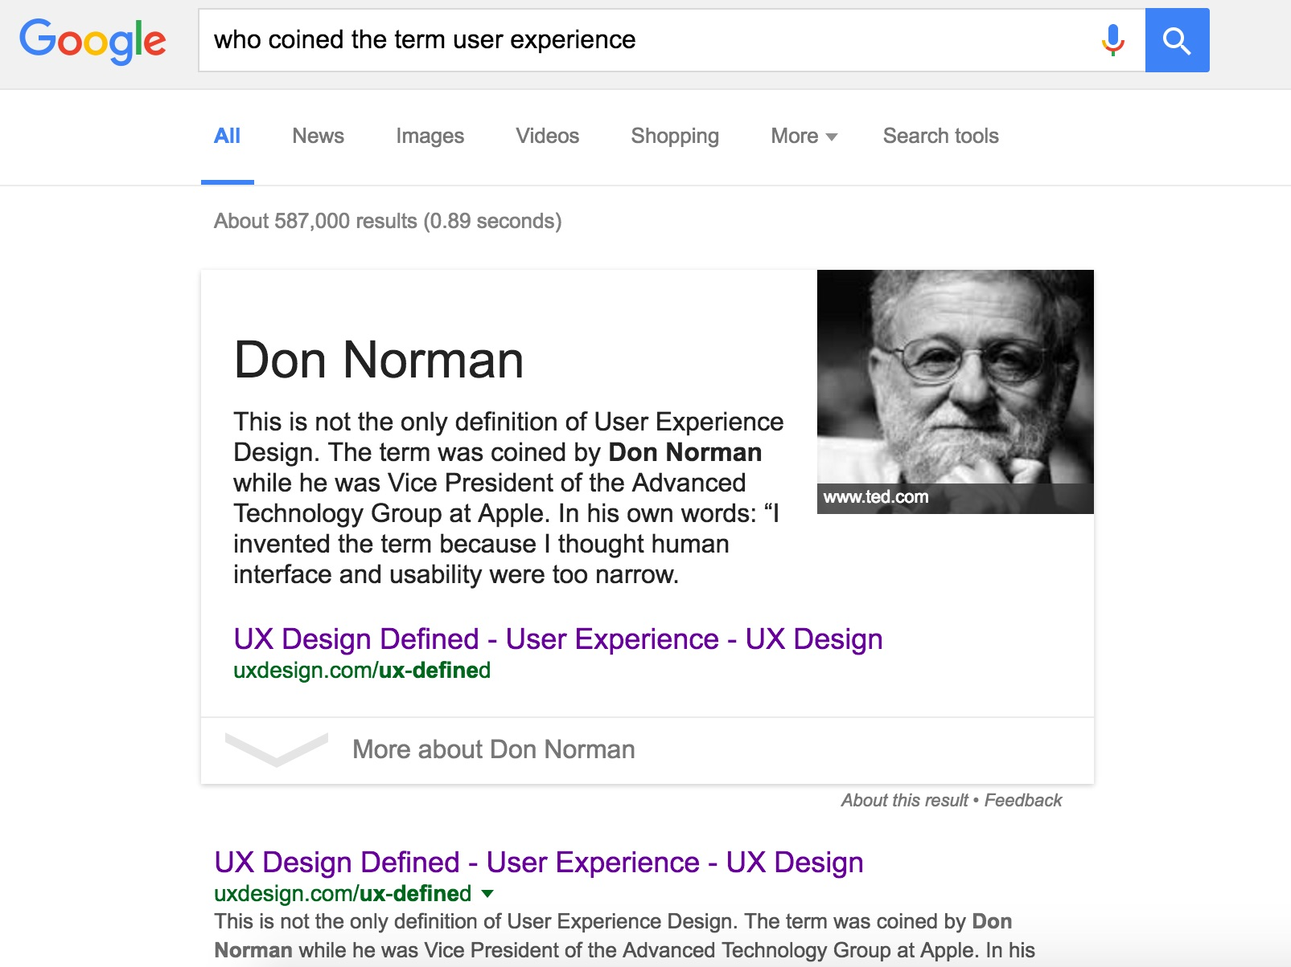
UX vs UI
UX: response time, …
UI: buttons, logo, colors, …

Slide 6
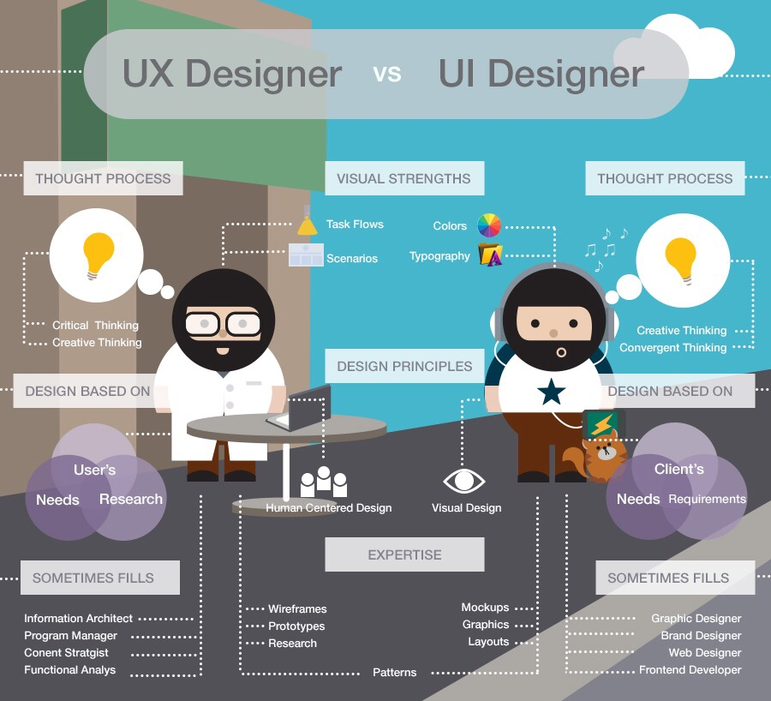
UX vs UI
To get a better understanding of why UX is not UI, UI is a small part of UX to some extent. However, UI design focuses more on colors and typography.
Let’s pick a textbook example. If there need to be a button, UI designers will concentrate on the visual part. Namely, how the button will look like and what color to use, whileUX designers are trying to figure out where to put it with the intention to find what users want and the resolutions to those pain points

Slide 7
UI Designer
Can
communicate with the developers smoothly, and promote the ultimate realization of interaction design and user interface
Should
make a pleasure interface and easy-to-use product to meet the users needs
have a plan for the product style, interaction design, interface structure and operation process according to the product demands
Responsible for
design the project in interactive interface, icons, logo, buttons and other related elements
optimize the webpage to make the operations more user-friendly
the art design of the software interface. He/she can always come up with new creative idea and make it real.
Notes:
© Copyright PresentationGo.com – The free PowerPoint template library

Slide 8
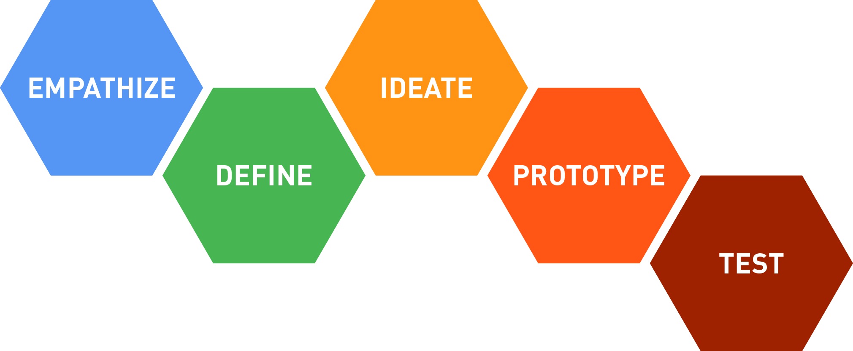
Design Thinking Process
https://dschool.stanford.edu/

Slide 9
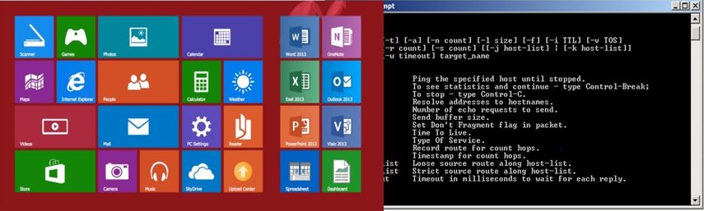
Are GUI and UI the same?
GUI is "graphical user interface" and UI is just "user interface." GUI is a subset of UI. UI can include non-graphical interfaces such as screen readers or command line interfaces (CLI) which aren't considered GUI.

Slide 10
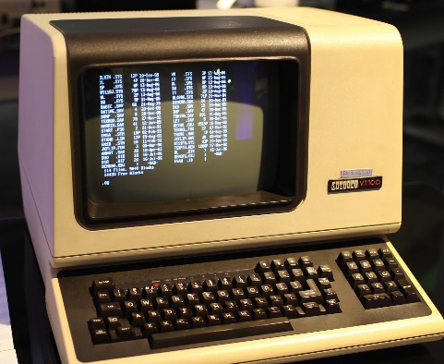
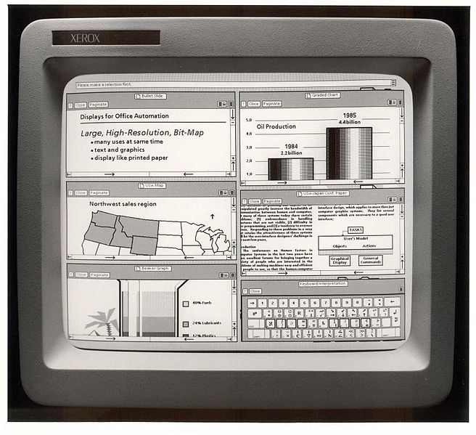
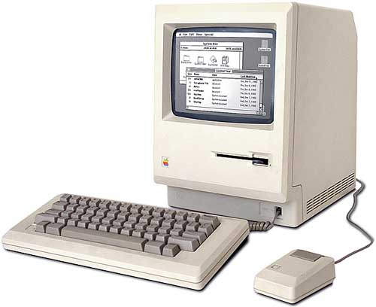
GUI History
1970th
1981
1984

Slide 11
Base GUI Design Principles
Attractiveness
High-level
business
performance
Usability

Slide 12
GUI Design Principles
The structure principle.
The feedback principle.
Your design should organize the user interface purposefully, in meaningful and useful ways based on clear, consistent models that are apparent and recognizable to users, putting related things together.
Your design should keep users informed of actions or interpretations, changes of state or condition, and errors or exceptions that are relevant and of interest to the user through clear, concise, and unambiguous language familiar to users.
The simplicity principle.
The flexibility principle.
Your design should make simple, common tasks simple to do, communicating clearly and simply in the user’s own language.
A static mockup can lose plenty of polish when it’s coded up into a live app. It keeps losing charm when it’s filled with real data, which is inconsistent at best—or often downright ugly.
The visibility principle.
The reuse principle.
Your design should keep all needed options and materials for a given task visible without distracting the user with extraneous or redundant information
Your design should reuse internal and external components and behaviors, maintaining consistency with purpose rather than merely arbitrary consistency, thus reducing the need for users to rethink and remember.
Notes:
© Copyright PresentationGo.com – The free PowerPoint template library

Slide 13
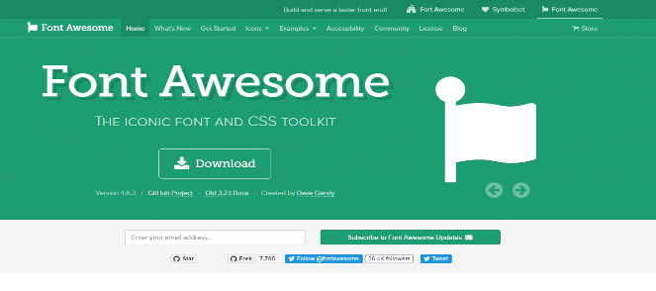
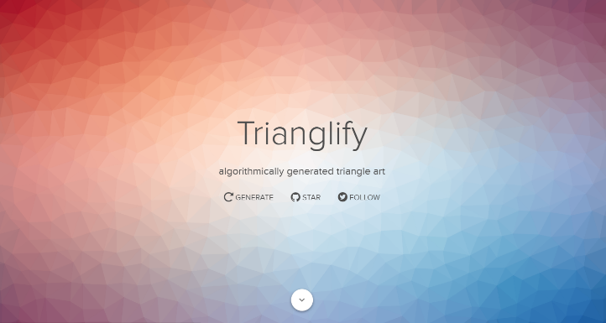
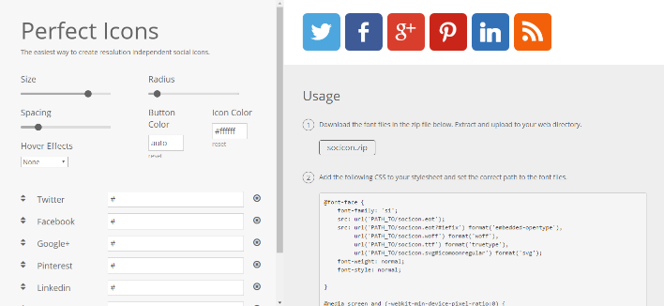
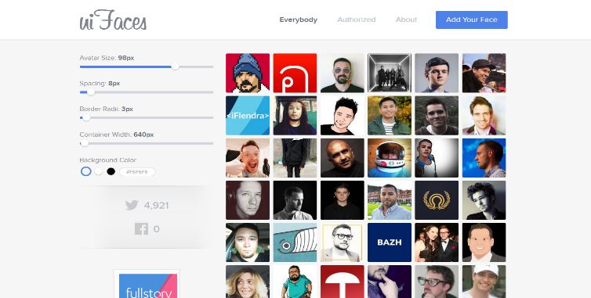
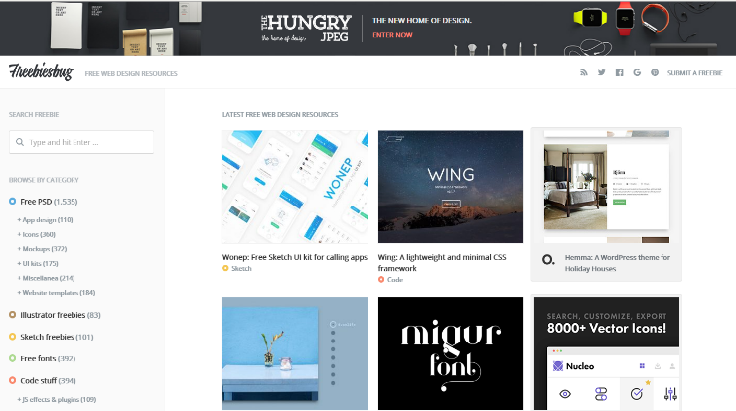
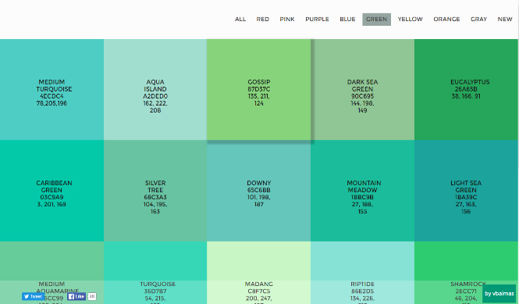
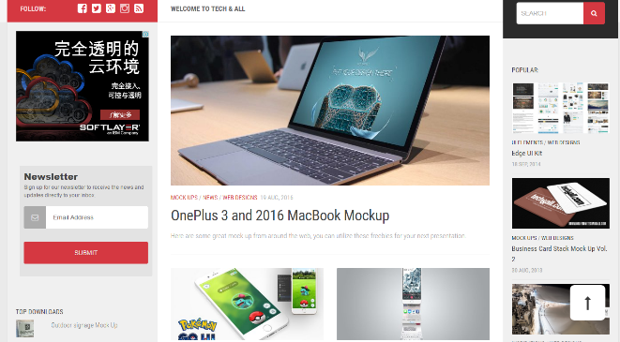
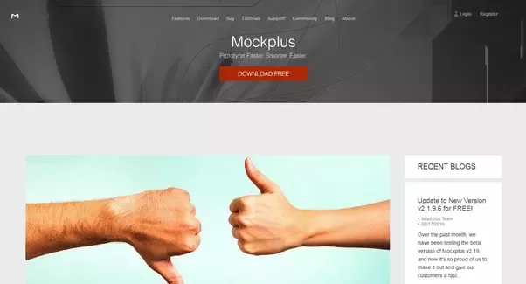
Design Tools & Websites for GUI Designers
Font Awesome
Trianglify
Perfect Icons
UI faces
Tech&All
Flat UI Color Picker
Mockplus Blog
Freebiesbug
Notes:
© Copyright PresentationGO.com – The free PowerPoint template library

Slide 14
What is mockup
Typically mid to high fidelity, mockups reflect the design choices for color schemes, layouts, typography, iconography, the visuals of navigation, and the overall atmosphere of the product.
Notes:
© Copyright PresentationGo.com – The free PowerPoint library

Slide 15
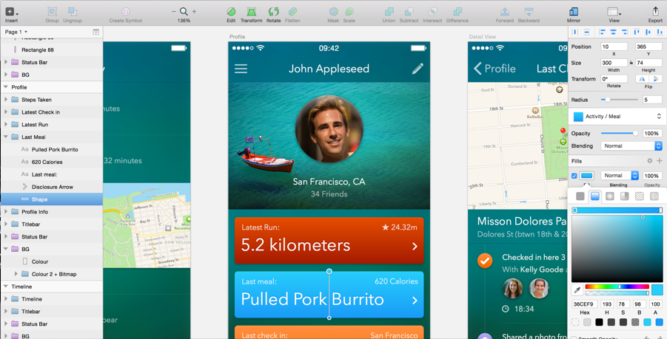
Mockups Benefits
1. Intuitive to stakeholders
2. Realistic perspective
3. Early revisions

Slide 16
Mockups vs wireframes and prototypes
The mockups are about presenting how what the final product would look like. The mockup model demonstrates all the graphics, typography, colors and other page elements.
Mockups
The wireframes are about functionality. While the wireframe is visually stunted, the mockup is close to the final version in appearance, though it lacks the functionality of a prototype.
Wireframes
Prototype generally gives customers and/or end-users an ability to click around the elements of the interface and simulate the way the app will actually work.
Prototypes
After wireframing and prototyping we can focus on the visual design of all elements.
Notes:
© Copyright PresentationGo.com – The free PowerPoint template library

Slide 17
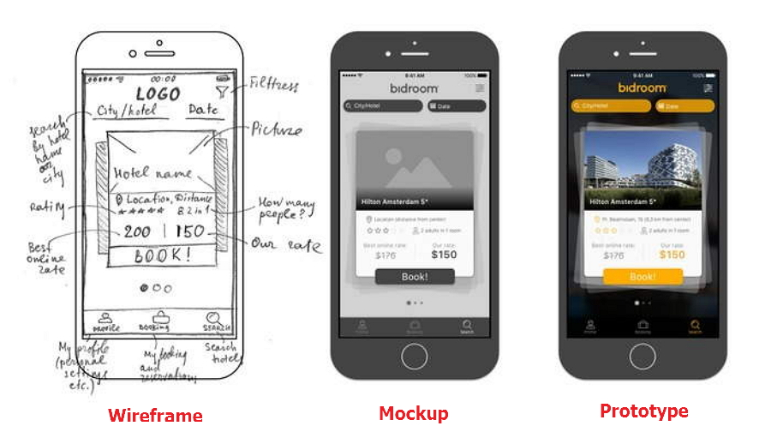
Mockups vs wireframes and prototypes

Slide 18
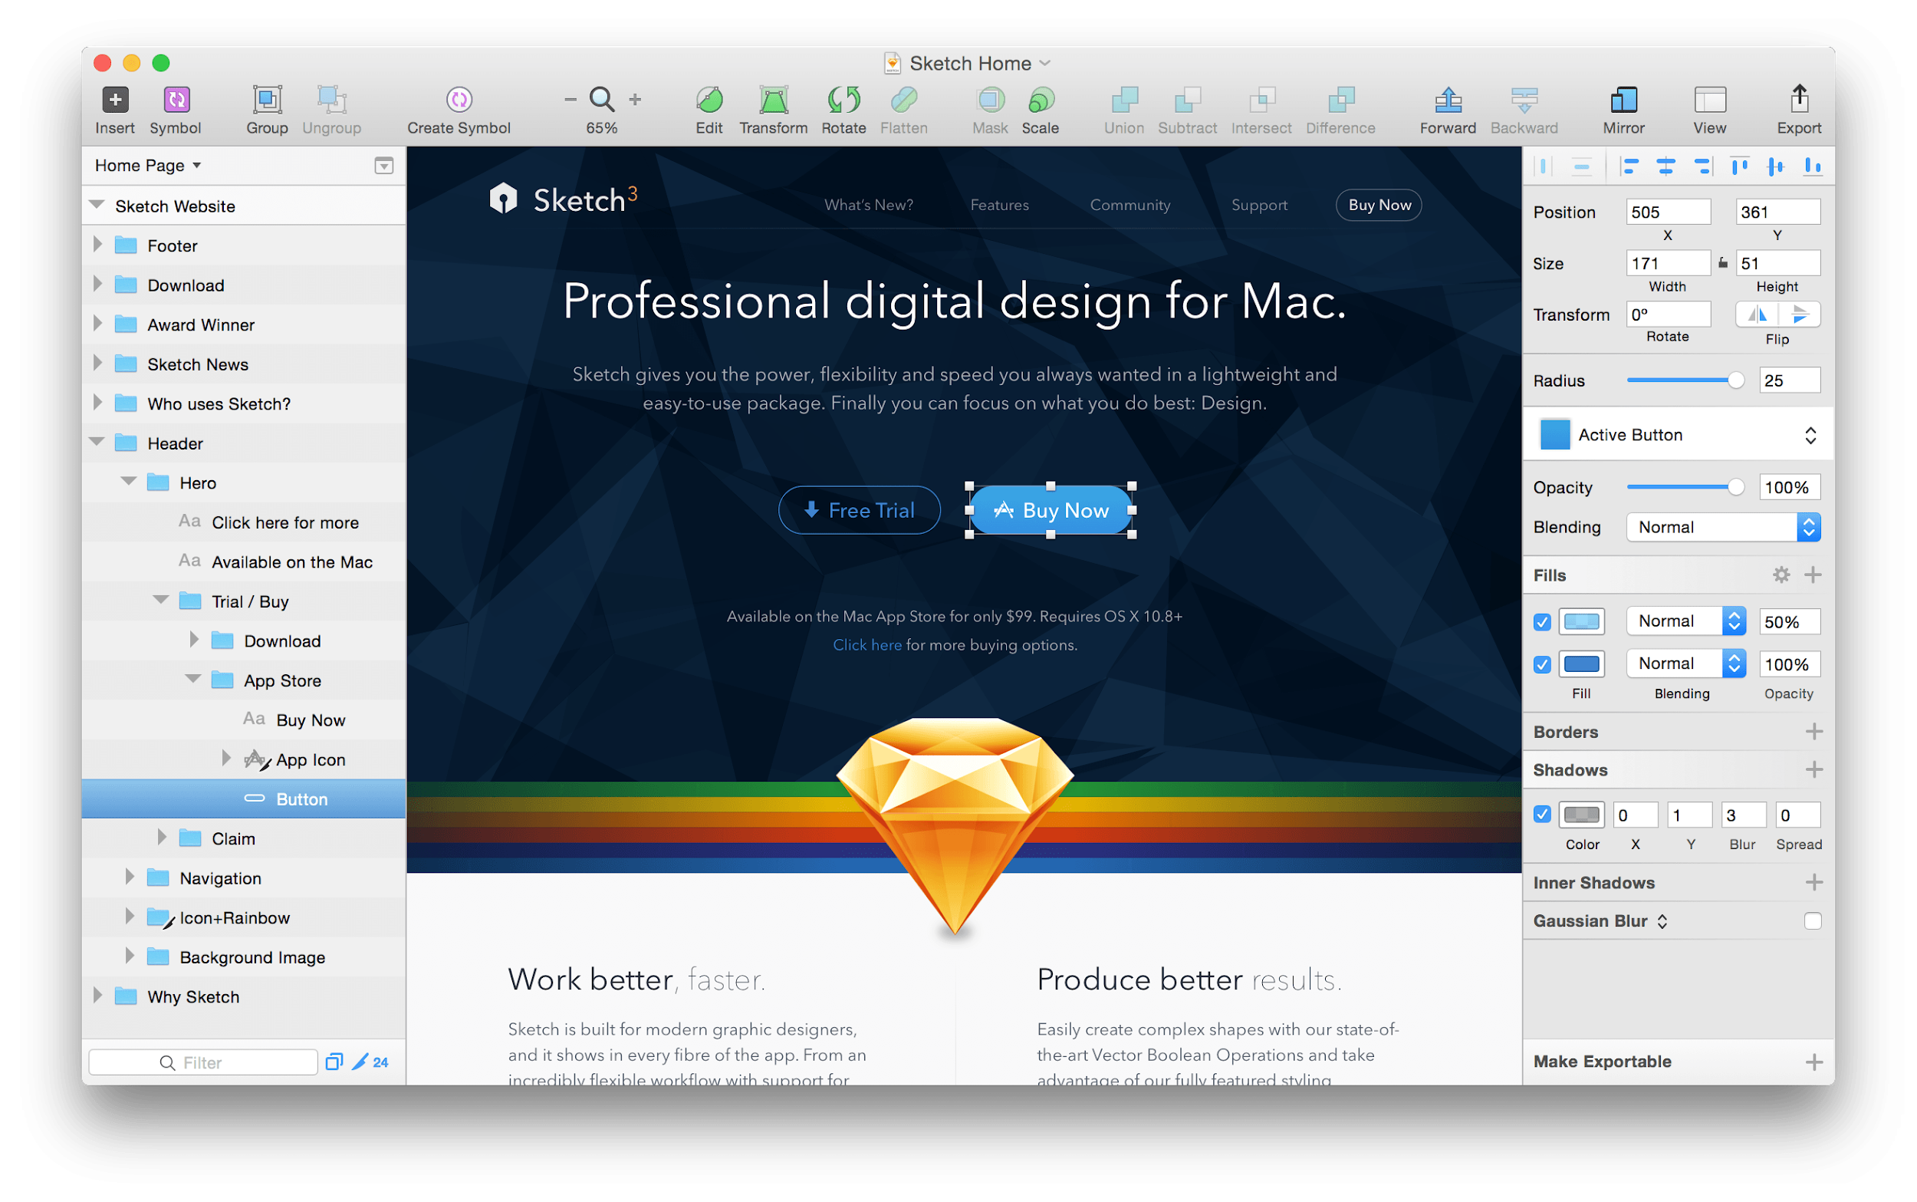
Mockups tools. Sketch
Best tool for interfaces for now
Expanding functionality with plugins
Great integration with interaction prototyping tools

Slide 19
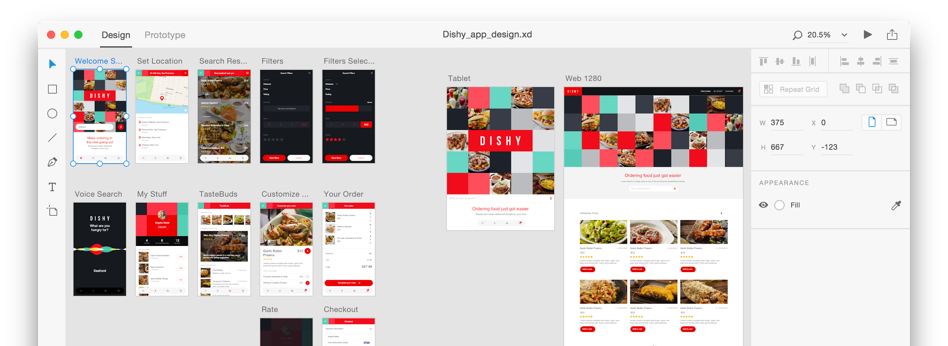
Mockups tools. XD
Free, fast and easy to start
Slow growth
Screen-based prototyping out of the box

Slide 20
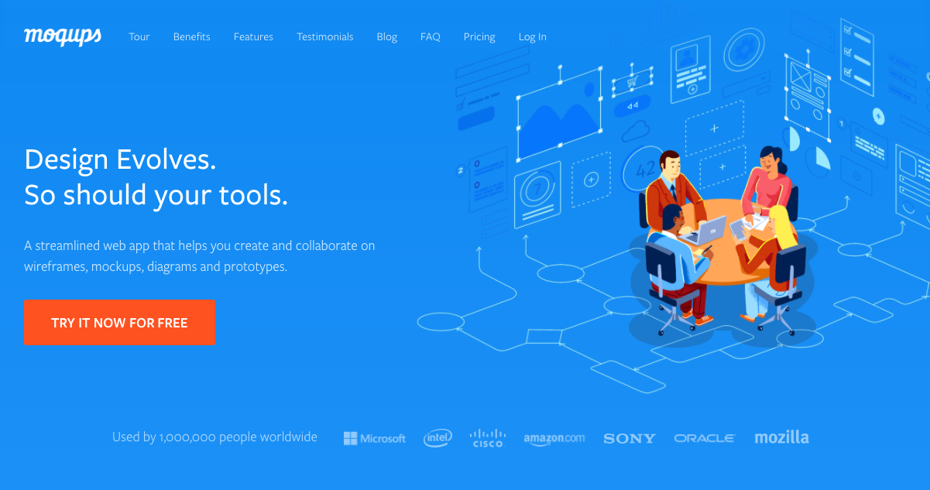
Mockups tools. Moqups
One of the best-known Web UI mockup tools for free Web application
Your efforts to find a desktop version will be in vain.

Slide 21
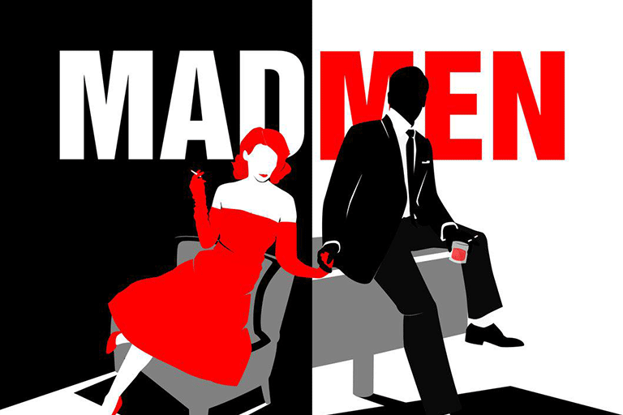
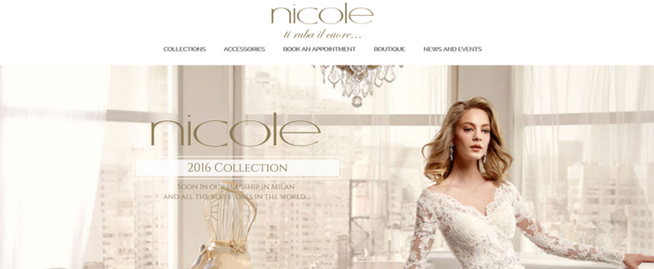
Common Errors of UI Designers
The design lacks of contrast

Slide 22
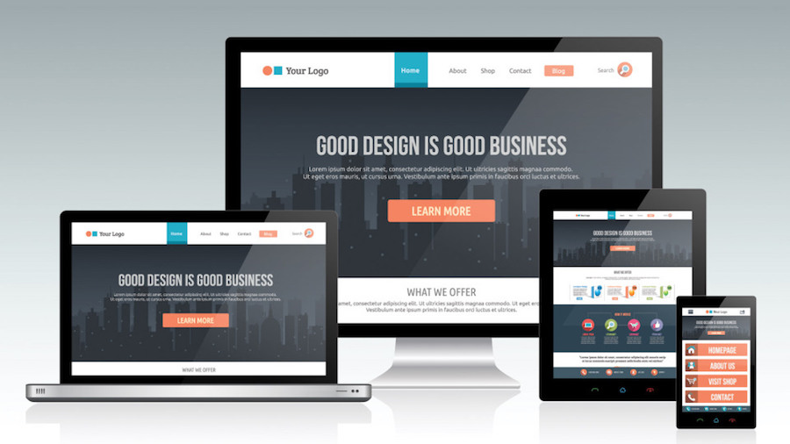
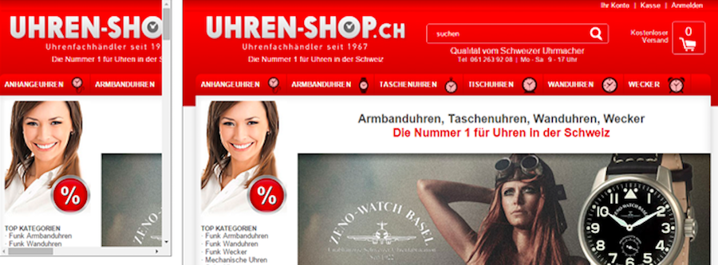
Common Errors of UI Designers
Not Responsive Design

Slide 23
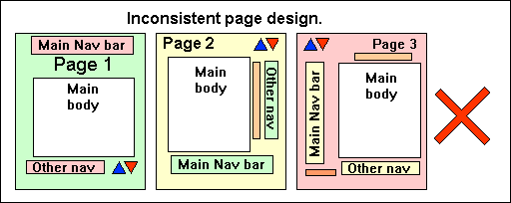
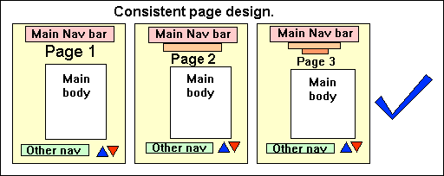
Common Errors of UI Designers
Inconsistent page design

Slide 24
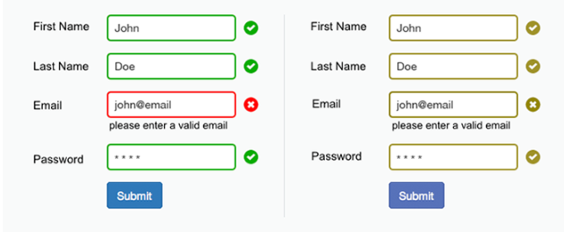
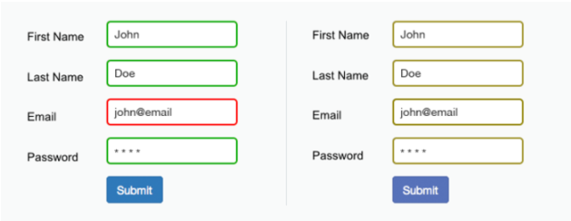
Common Errors of UI Designers
This form relies only on red and green to indicate fields with and without errors. Users who suffer from deuteranopia (red-green color blindness) wouldn’t be able to identify the fields.

Slide 25
Typical Mistakes People Make in Website Design
A Cluttered Homepage
Color Overload
#1
#3
#2
#4
Clueless Navigation
Bad Readability

Slide 26
Navigation Menu Design
1
5
Easy to find
Clearly
2
6
Easy to operate
Keep it simple
3
7
Clickable
Style
4
8
Consistency
Accessibility
Notes:
© Copyright PresentationGo.com – The free PowerPoint template library

Slide 27
Common Mistakes In Buttons Design
Reset button
Too small buttons
Hard to see buttons
If a mistake is made, he/she can edit it rather than resetting all the contents and restarting.
Make buttons BIG! When you create website buttons, you should make sure people can see the “order now” buttons if you really want them to click it.
When you create website buttons, you ought to notice that the color of the button should be distinctly separated from that of the website background
1
2
3
It’s just logical that buttons to move you forward should be on the right, and buttons to move you backwards should be on the left.
In order to be a seemingly “original” one, some designers may create website buttons that are very very fancy which however look totally different from the familiar buttons.
4
5
Buttons in the wrong places
Fancy buttons
Notes:
© Copyright PresentationGO.com – The free PowerPoint template library

Slide 28
Common Mistakes In Buttons Design
Buttons with generic labels
Too many buttons
Ugly buttons
Not all buttons can be named as “submit” or “next” based on the action that follows. Ideally, the button’s label should clearly describe its action. For instance, “Next Step”, “Checkout” or “Update My Profile”.
Users can be very confused and end up doing nothing and just leaving if they are faced with too many buttons. When you create website buttons, choose the most significant action you want your users to take and use one big and clear button.
Some buttons are so ugly that all you want do is to keep the cursor as far from them as possible.
6
7
8
If users are required to click a button, they should be told the function of the button before clicking it.
Buttons that flash, rotate, or have horrible animations will just disgust and distract your users. These kinds of buttons used to be popular in the early days of the Internet. Unfortunately some survived..
9
10
Buttons without labels
Obnoxious button
Notes:
© Copyright PresentationGO.com – The free PowerPoint template library

Slide 29
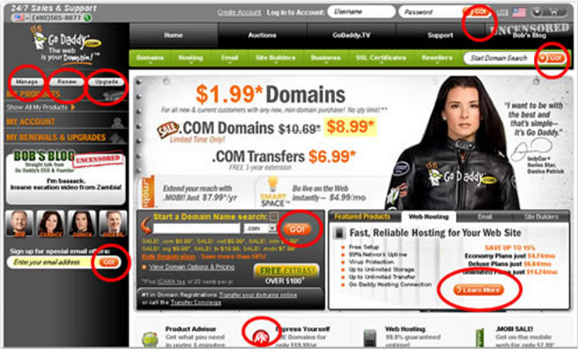

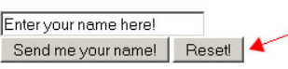
Too many buttons
Common Mistakes In Buttons Design
Obnoxious button
Reset button
Notes:
© Copyright PresentationGo.com – The free PowerPoint library

